Slide 1
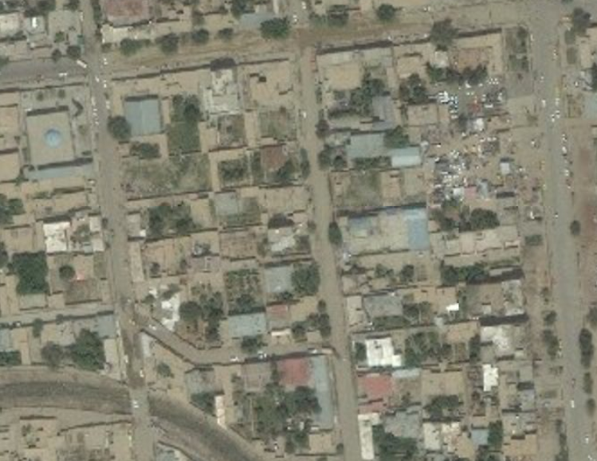

TARGET: JOE NOBODY
UNCLASSIFIED (EXAMPLE)
1-I ID
NUMBER: UN4789 AREA: SPRINGVALE STREET: HOUSE:
Targeted by: 1-1 ID Area of Operations: HH 2-7 Trigger: HUMINT
DOI: 16 FEB 2014
TASK: DETAIN
GRID: 42S WD 11466 18314
PHYSICAL DESCRIPTION
Last given bed down grid for Joe Nobody is from 05 JAN 2014 IIR 13-DC-12-34-88-34
Sex: Male
Age: 38
Height: 6’3”
Body Comp: Normal
Eyes: Hazel
Hair: Brown
Other details: Dresses like a soccer player. Possible Eastern European acccent.
5
TARGET INFORMATION
Target Category: Terror cell
Impact: Disrupt terror cell
Possible aliases: Unknown
Vehicle: Poss Lexus SUV
Family: Unknown
Religion: Unknown
STATUS:
PID:
✓
TARGET SUMMARY: Joe Nobody is an international terrorist. He has been linked to several attacks and supplies weapons and explosives training.
Source:
✓
Location:
X
Intnl Cost:
✓
Source: HUMINT
Evidence:
✓
Trigger:
?
UNCLASSIFIED (EXAMPLE)
Last update with: HUMINT

